Slide 1
Project Title
Investigation into the distribution of medical care facilities in the United States
Group Members:
James Bruning
Sabyasachi Das
Nick Kelly
Project Goal
Explore the relationship between the number of healthcare facilities available at the state and local level in America and population, median income, quality of care, and health outcomes.

Slide 2

Motivation: Story
-Is access to quality healthcare severely limited for rural Americans?
-Rural Americans make up 20% of the population with fewer than 10% of the doctors
- Ed Garner works in an area roughly the same size of Maryland but is the only active doctor within that area
- There will be a 23% decline in the rural doctors within the next decade
- For example, in Texas alone 159 of the states 254 counties have no general surgeons
Source: American Hospital Association: https://www.aha.org/system/files/2019-02/rural-report-2019.pdf
Summary of Findings:
For hospitals:
US has mostly acute care hospitals.
State wise, Texas has most hospitals, followed by California
Although most hospitals in Texas have a higher overall quality than national average, the same cannot be said about California.
There is hardly any correlation of the number of hospitals in a region with the median income in that region
There is significant correlation between the number of hospitals and the population of the region.
2. For Home Health Care:
The majority of ownership is “Proprietary” and owned by individuals
As with hospitals the majority of the Home Healthcare units are located within high population cities such as in Texas, California and Florida
Based on ownership there is no distinct difference in quality of care and this is consistent across states
3. For other health care facilities:
There is little correlation between the number of pharmacies and free clinics per thousand people and the median family income per state.
There is also little correlation between the number of pharmacies and free clinics per thousand people and the average life expectancy per state.
Notes:
James

Slide 3
Major questions investigated
1. How are different medical facilities like hospitals, home healthcare agencies (HHCs) and pharmacies distributed in the United States?
2. What is the quality rating of these medical facilities?
3. How can these medical facilities be sub-classified based on their ownership and/or services they provide?
4. Is there any correlation between the number of these different type of medical facilities and factors like population and median household income?
Data sources:
Data needed | Source
Information about quality and locations of hospitals in United States | Data.gov
Information about quality and locations of home health care agencies in United States | CMS.gov
Information about quality and locations of pharmacies in United States | USA RX FreeClinics.Com
Median household income of different counties in United States | US Census Data
Population of different counties in United States | US Census Data
Notes:
Sabya

Slide 4
Hospital Data
HHC Data
Pharmacy & Free Clinic Data
Problems:
The quality parameters like mortality, safety of care, readmission, patient experience, effectiveness of care, timeliness of care and efficient use of medical imaging were all comparisons with national average instead of absolute numbers.
Some quality data were not available, and the missing information was inconsistent across columns.
A “Location” column containing the full address was not properly formatted.
Problems:
Categories were not uniform and consistent across the dataset (such as ownership type)
For geocoding the data was split up into State, Address, ZIP, and City
Having to create maps based around Income Levels instead of just population
Problems:
It was difficult to find a dataset or API that provided data on individual pharmacies. The one we found turned out to be unreliable.
Thus, individual statistics such as coordinates, quality of service, wait times, etc. were out of reach.
Similar issues came up when collecting data on free clinics
Solutions:
If a quality parameter was better than national average, it was assigned a score of 1; -1 for worse performance and 0 for average
The rows with information missing on more than half of the quality parameters were excluded. The rest were assigned a score of 0.
A new properly formatted column was constructed using individual columns for Street Address, City, State and ZIP.
Solutions:
Had to rename and replace values/identifiers based upon a criteria that we found to be consistent both with HHC data and hospital
Had to use both a new string concatenation and also find a way to eliminate “Suite” or “Apt” strings and numbers from address line
Need to learn basics to a type of package inside Python that would allow for new heat map
Solutions:
Changed the scope of our research to the state-level, where data is more easily available.
Analyzed the number of pharmacies and free clinics against population, median income, and life expectancy by state.
Notes:
James, Sabya, Nick

Slide 5
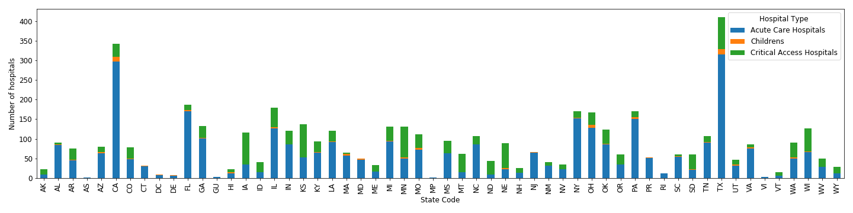
Most hospitals have acute care
Children's’ hospitals are very low in number
Critical access hospitals:
Have 25 or fewer acute care inpatient beds
Be located more than 35 miles from another hospital
Maintain annual average length of stay of 96 hours or less for acute care patients
Provide 24/7 emergency care services
Acute Care Hospitals:
Acute care is a branch of healthcare where a person receives active but short-term treatment for a severe injury or episode of illness, an urgent medical condition, or during recovery from surgery.
Lesser critical access hospitals mean that there are less standalone hospitals that do not have another hospital in a 35 mile radius
Notes:
Sabya
Data analysis
Discussion of plots
Hospitals

Slide 6
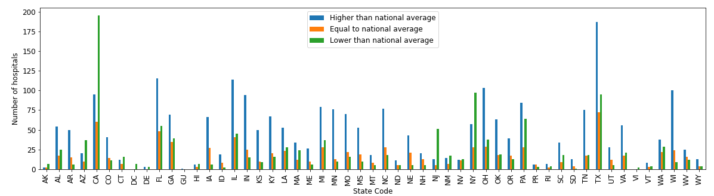
Quality Parameters:
Mortality, Safety of care, Readmission, Patient experience, Effectiveness of care, Timeliness of care and Efficient use of medical imaging
Texas has most hospitals with quality of care better than the national average
AK, AZ, CT, NJ, MN, NV, NY are the states that have more hospitals with quality of care lower than the national average

Slide 7
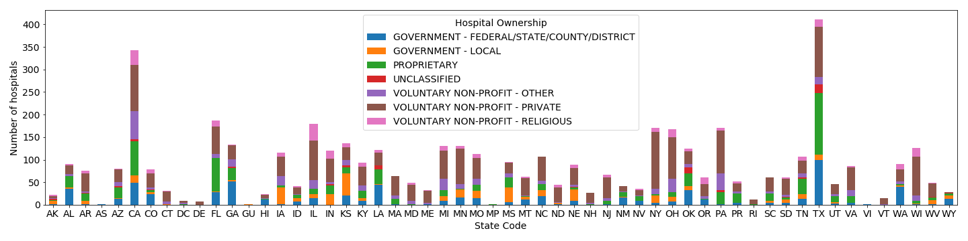
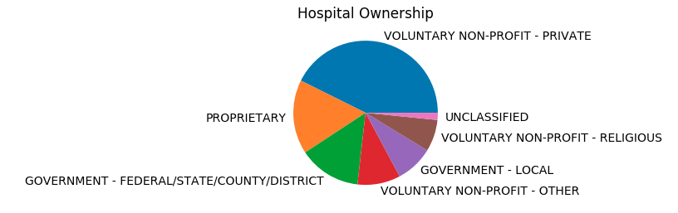
More private than government hospitals
Proprietary hospitals come in second after voluntary non-profit private hospitals

Slide 8
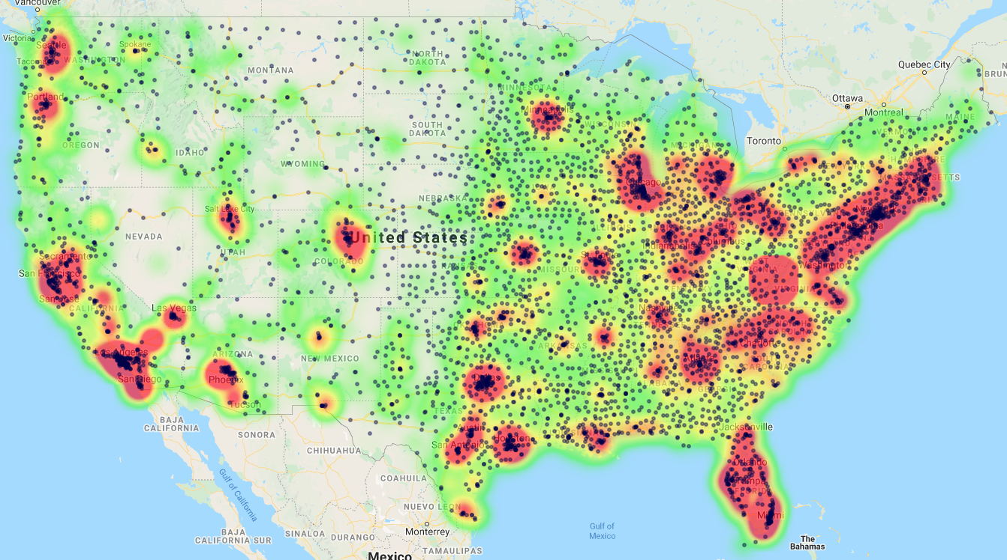
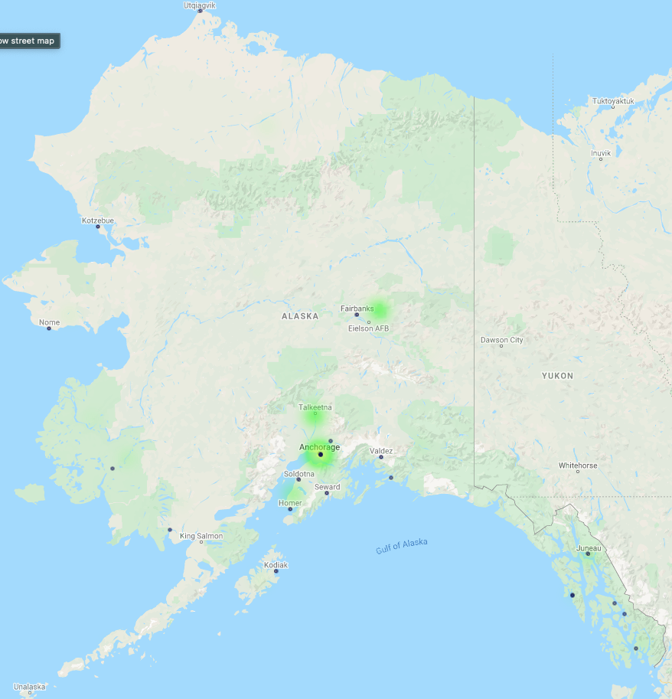
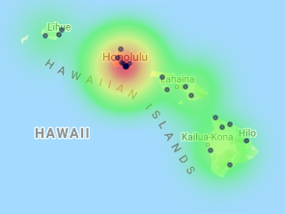
Population Heat Map
ALASKA
HAWAII

Slide 9
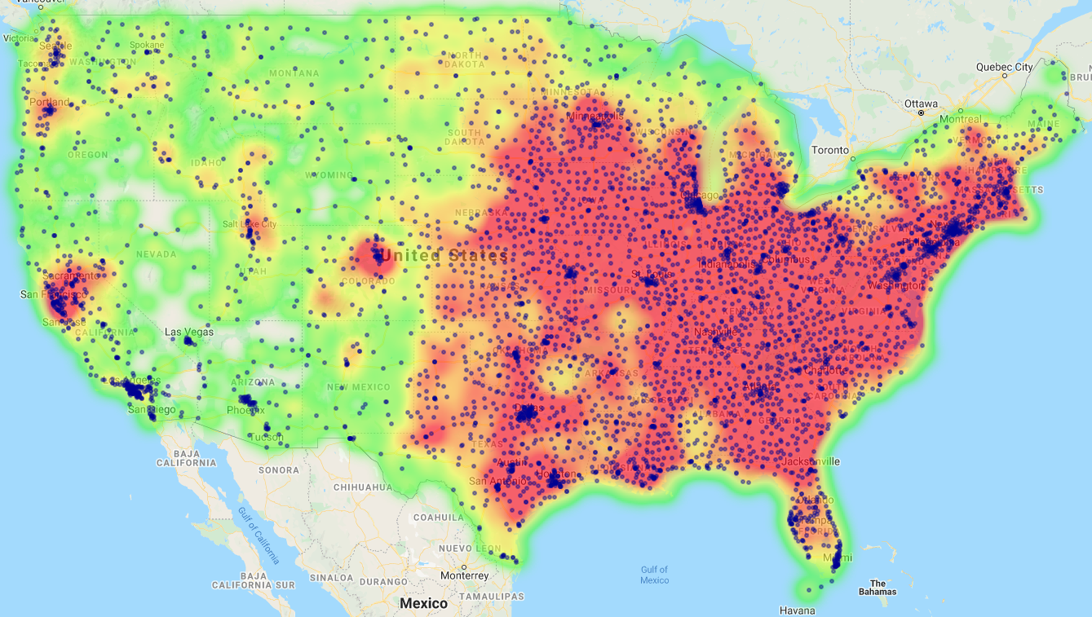
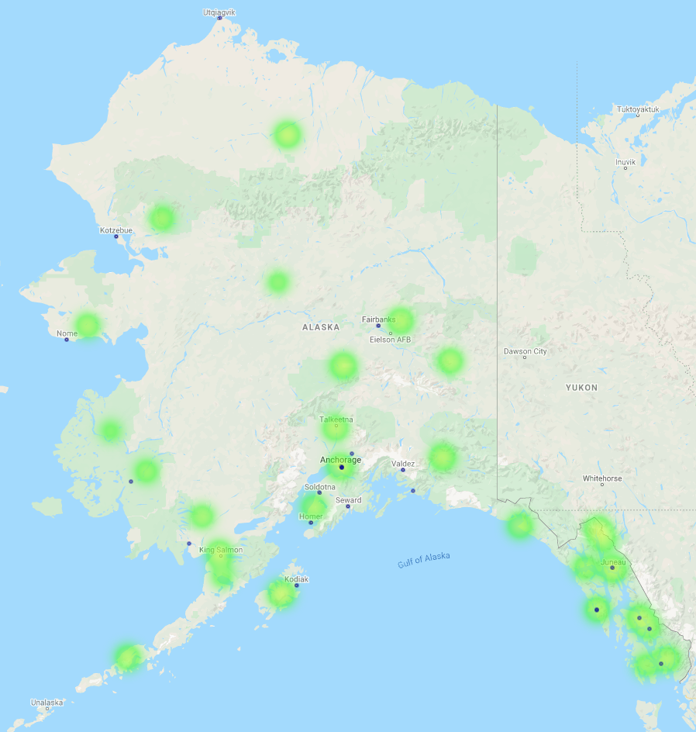
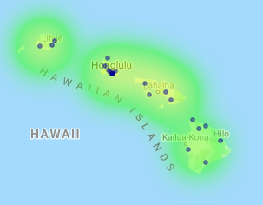
Median Income Heat Map
ALASKA
HAWAII

Slide 10
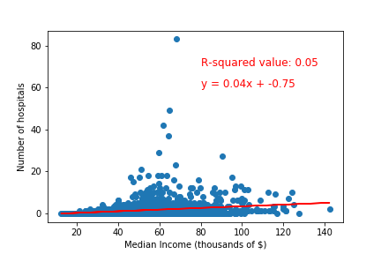
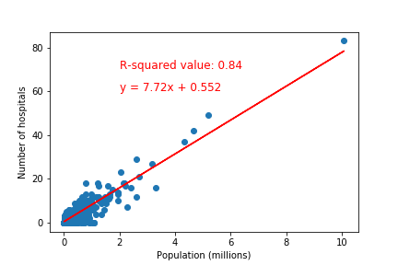
Most hospitals are seen in regions where the median incomes are in the range of $50,00 to $70,000 per year.
However, there is no correlation
There is direct relation between number of hospitals in a region and the population of the region

Slide 11
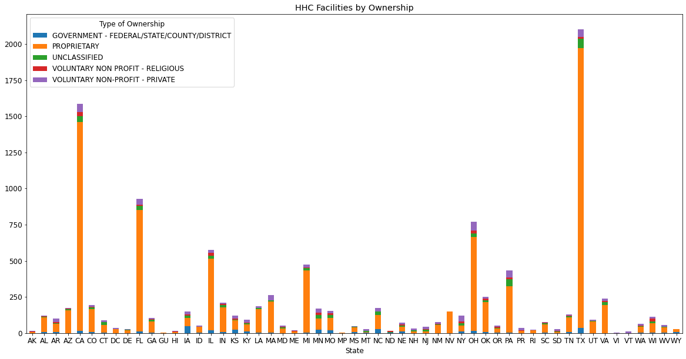
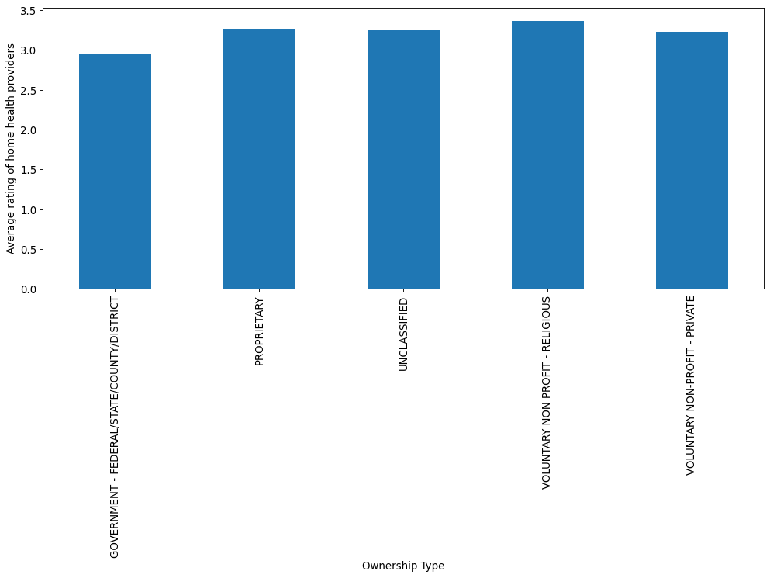
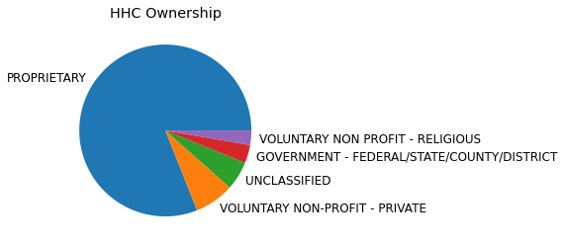
Overwhelming majority is based on “Proprietary” ownership with no real states showing outliers
No real changes between ratings of different ownership types

Slide 12
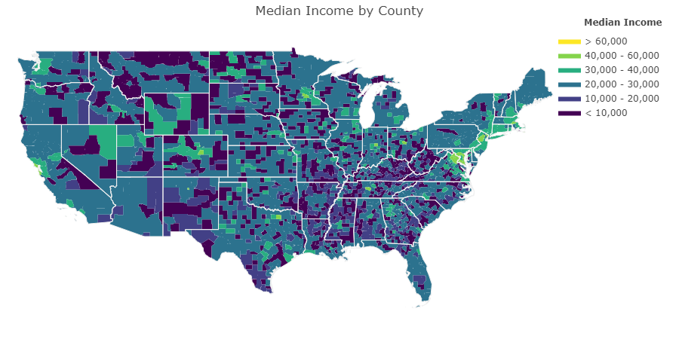
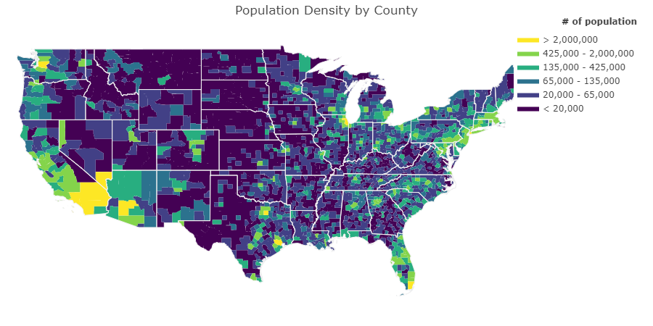
Population Density vs Median Income

Slide 13
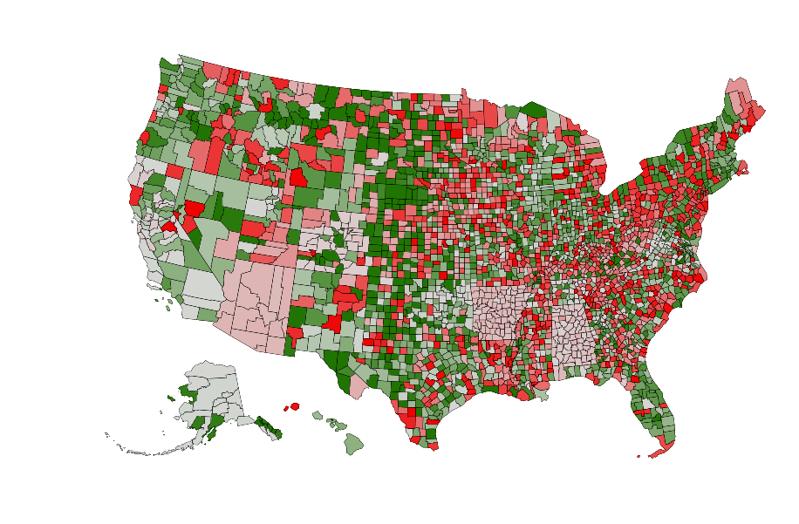
Pharmacies per 10k Residents By County
Source: USA RX, https://www.usarx.com/pharmacy-deserts
Notes:
James

Slide 14
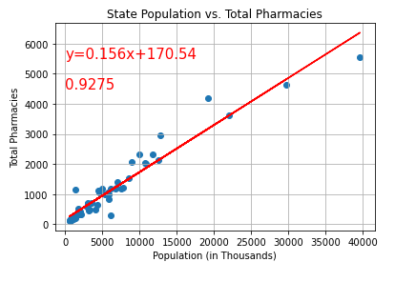
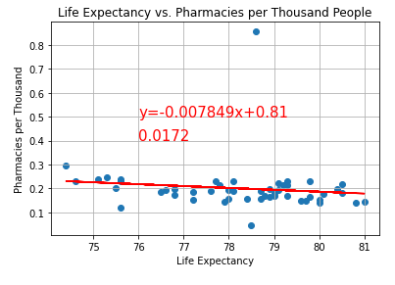
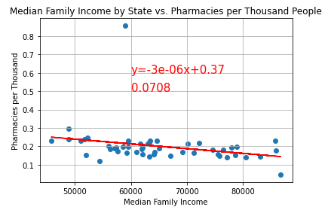
Pharmacy Analysis
Neither average life expectancy nor median family income were found to correlated with the number of pharmacies, once state population was controlled for.
Sources:
The Center for Disease Control, https://www.cdc.gov/nchs/pressroom/sosmap/life_expectancy/life_expectancy.htm
US Census Bureau, https://www.census.gov/library/visualizations/interactive/2019-median-household-income.html
Notes:
Nick

Slide 15
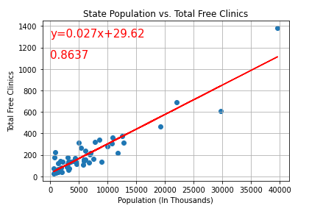
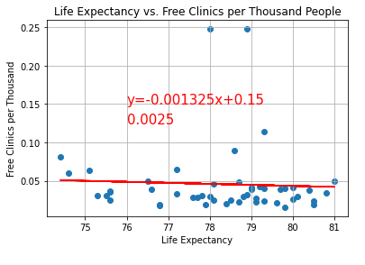
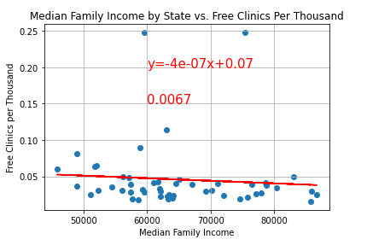
Free Clinic Analysis
Similar to pharmacies, the number of free clinics per thousand people had no strong correlation with life expectancy or median family income.
Sources:
The Center for Disease Control, https://www.cdc.gov/nchs/pressroom/sosmap/life_expectancy/life_expectancy.htm
US Census Bureau, https://www.census.gov/library/visualizations/interactive/2019-median-household-income.html
FreeClinics.Com: https://www.freeclinics.com/

Slide 16
Conclusions:
Hospitals in the United States are more concentrated in the population centers but have no correlation with the median income of the population residing in a region.
While the direct correlation with the population was expected, the absence of any relation with median income was not expected. The highest number of hospitals were recorded for a median income of around $70,000, which is near the center of the median income range
Most hospitals in US are private, which is expected.
The quality of hospitals in California was surprising, as more hospitals in the state have an overall rating of below average.
There was not a strong correlation between income levels and # of HHC in a general state level, but since we did not break down into distinct county regions, this could be incorrect as there will be heavy over saturation of HHC in urban areas and not account correctly for distance separation in rural areas
Quality of care seemed to fairly consist across ownership, but state by state varied with most states receiving above a 3.0 rating for their threshold
There does not seem to be a strong correlation between median household income and the total number of pharmacies or free clinics in a state, but the use of these insights are limited without more information at the county and local levels.
Notes:
Sabya

Slide 17
Future Work:
Look for data that allows analysis at a more local level for pharmacies.
Use these results to investigate identification of medical deserts in US and their dependence on parameters like median income, population and other social parameters
What are Medical Deserts?
Medical deserts are regions, where one is 1 hour or more away from the nearest acute care hospital. The Federal Government has currently designated 80 percent of rural America as medically underserved.
Source: https://carolinianuncg.com/2019/10/02/medical-deserts-in-america/
These areas are characterized by several parameters such as a poor number of health professionals, remoteness or high needs of care.
Source:"Medical deserts" and accessibility to care: what are we talking about?-Gabrielli, Chevillard(MedSci Paris)
What is required?
Proper definition of parameters that characterize a medical desert.
Collect data from different sources on these parameters at a granular level (at least county).
Use Google NearbyPlaces API to get information in a fixed radius around different medical care facilities to verify the existence of medical care deserts.
All this would require more time and a larger budget!!!

